Slide 1
Integrated Visual Landing Aid Sensor
PSU Capstone 2019

Slide 2
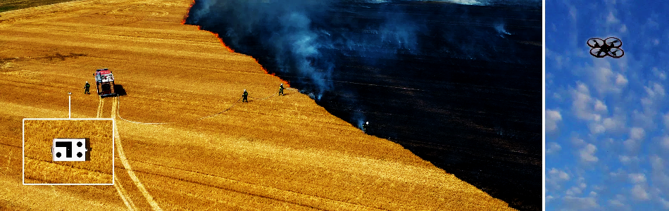
OBJECTIVES
Select an affordable quadcopter & autopilot for demonstration
Integrate 1500-OEM with autopilot
Create a custom board or harness for easy integration
Demonstrate safe landing from a fixed height
Create documentation / tutorials

Slide 3

Landing Aid
Large outer pattern allows detection from large distance
As platform gets closer, algorithm switches to inner pattern
Reverse contrast
Pattern is known to software ahead of time
constantly “looking”
no training needed
Target center is returned as pixel coordinates (row, column)
Specific pattern geometry allows calculation of angle of rotation (degrees)
Geometry of pattern also allows calculation of distance to target
Small target = farther away, Larger target = closer
Requires knowledge of lens Field of View (FoV)
All of which gets translated into controls to autopilot

Slide 4
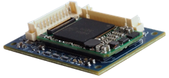
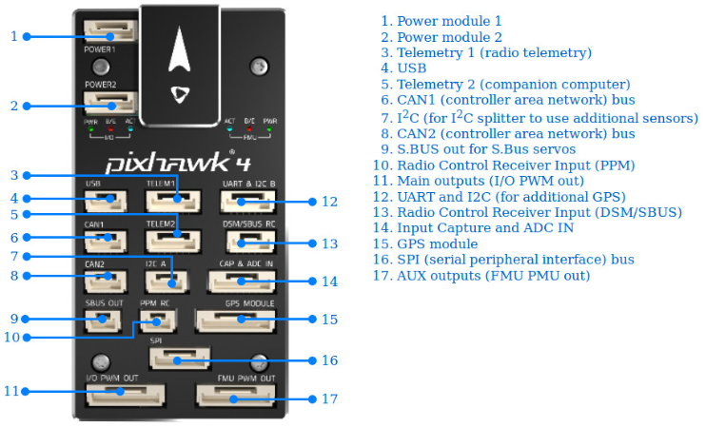
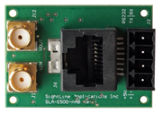
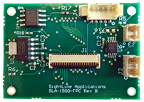
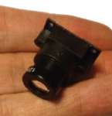
Hardware
???

Slide 5
Hardware
How to power 1500 & camera
4.5 to 5.5V DC
2 - 3 Watts with camera, etc.
connectors & cables
Battery life
How to communicate with autopilot
RS-232 or 3.3VTTL
Optional: i²c not recommended
How to mount to aircraft
Weight
Physical position
Balanced, clear of obstacles, etc.
Mechanical coupling and enclosure - nuts and bolts kind of things
Camera selection
SightLine camera
Operational Height vs Lens selection
See Lens / FoV calculator

Slide 6
Hardware Goals
Phase 0 - Pick a Platform
Pixhawk quad-copter or similar
Suitable for indoor & outdoor use
Find a “kit”
Phase 1 - Simple cable harness
1500-OEM to Pixhawk - Power and communication
Quick prototype - allow software to be tested, understand aircraft control, etc.
Everything else is already available
Phase 2 - Build a camera board
Combine 1500-FPC and sensor reference design into a single board
Serial Connector (3-pin molex) to Pixhawk
Power connector (2 or 4-pin molex) from batter or Pixhawk
Digital video connector (50-pin Hirose)
Parallel digital video
i2c sensor control
Power
3.3V TTL serial
Mounting for lens
Phase 3 - Mechanical: Find, design, or otherwise build a simple enclosure

Slide 7
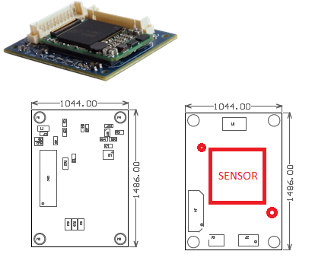
Mockup
Digital Video
Power
Serial
Pixhawk
Power
Command and Control

Slide 8
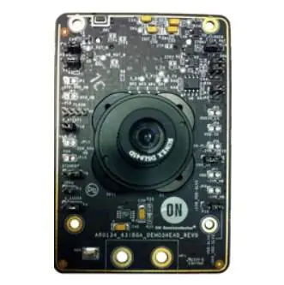
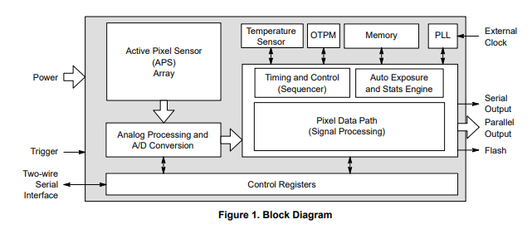
Camera Sensor
AR0134 ON Semiconductor Monochrome Image Sensors
1280 x 960 (1.2 MPixels)
Monochrome
-30° to 80°C
Evaluation Board here
Schematics etc should all be available
SightLine already works with 3rd party board built on same image sensor
Reduces software need for sensor command and control (should “just work”)

Slide 9
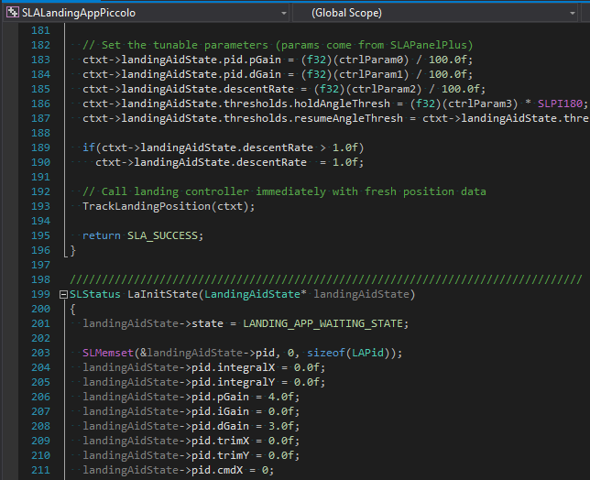
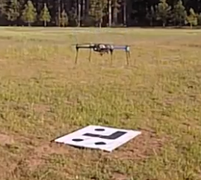
Software
???

Slide 10
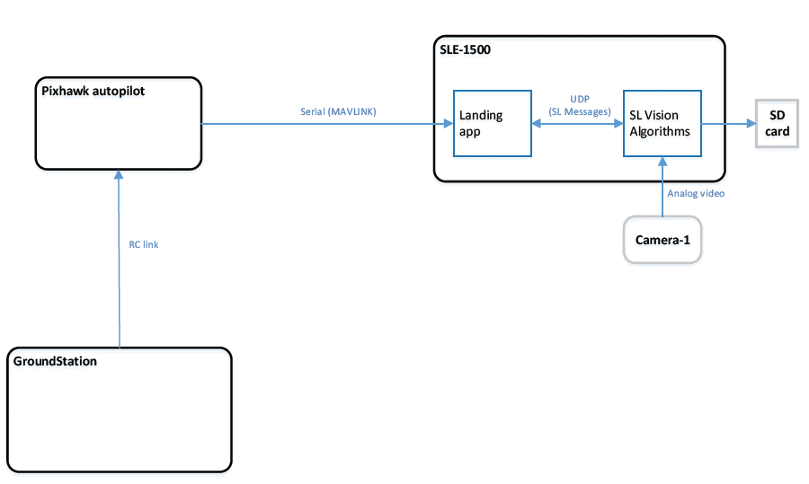
Communication

Slide 11
Software Goals
Phase 0 - Become familiar with basic quadcopter control (Mission Planner?)
Phase 1 - Compile and install SightLine Sample
SightLine has sample code ready to deploy on our hardware
Verify serial comms to Pixhawk are functional
Understand outputs and how they relate to Phase 0
Phase 2 - Tuning
Experiment with landing pattern and output to determine how they affect the gains used to control the quadcopter
Modify existing sample code to read in parameters for tuning
Phase 3 - Dynamic Tuning
Create / Utilize a command and control interface for tuning parameters at runtime

Slide 12
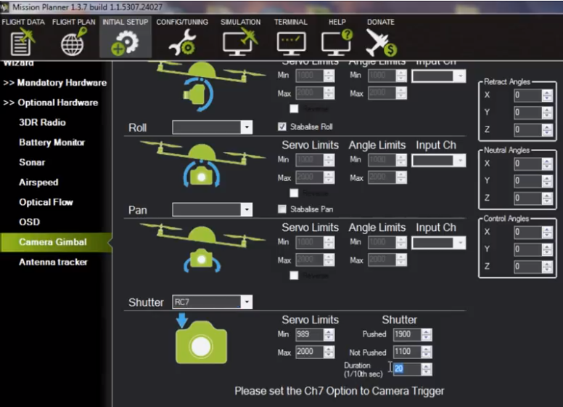
Software - Mission Planner
Used to configure and control the aircraft
Can a custom “widget” be created to configure the software running on 1500?

